Slide 1
MEC 402 Casting, Welding and Forming
Dr. Arjyajyoti Goswami
arjyajyoti.Goswami@me.nitdgp.ac.in
+91-9953167384

Slide 2
Gas Tunsgten Arc Welding:
What is Gas Tungsten Arc Welding
Set up for GTAW
Electrode tips in GTAW
TIG vs MIG

Slide 3
Why study about it
To understand the different salient features of GTAW, most notably, the set-up, electrode tips in GTAW, TIG vs MIG.

Slide 4
GTAW was developed mainly for welding of thin sheets and difficult to weld metals like Aluminium and Magnesium.
Mere cathodic cleaning was not enough to make them weldable, large heat concentration was needed for that. GTAW enabled that, without complicating the process (as in SMAW and GMAW).

Slide 5
Gas Tungsten Arc Welding (GTAW) or Tungsten Inert Gas Welding (TIG)
GTAW or TIG is a type of Arc Welding process in which fusion is achieved between 2 metallic workpieces utilizing the heat obtained from an arc struck between the workpiece and a non consumable Tungsten electrode. The arc is continuously shielded by a protective covering of inert gas.
Arc is between workpiece and Tungsten electrode – hence Tungsten
Shielded by inert gas – hence Inert
Together - Tungsten Inert Gas Welding or TIG.
GTAW uses a Tungsten electrode, mostly in hand held mode of operation (steeply drooping or constant current power source).

Slide 6
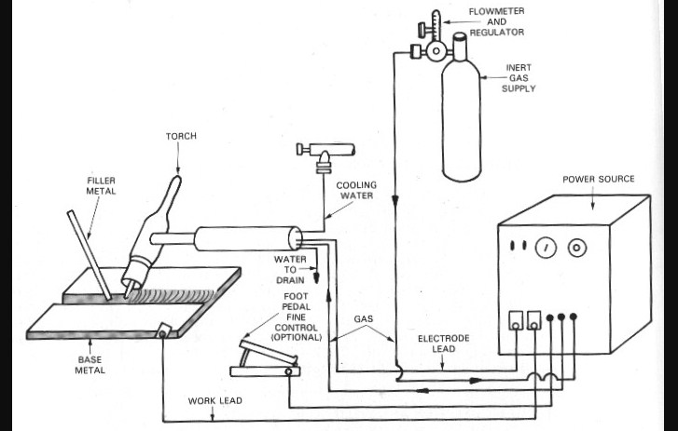
GTAW
https://www.weldingis.com/gtaw-welding/

